Slide 1
Course Title
BIO 101/ GENERAL BIOLOGY 1 (2 Units)
PROF (MRS) I.A . KEHINDE

Slide 2
Section Title

Slide 3
Cryptogams : (Kryptos (hidden) gameein (Marry) “Hidden reproduction
Flowerless or seedless plants, lower and primitive. Reproduces by spores
Thallophyta, Bryophyta and Pteridophyta
Algae, Fungi, Lichens, Bryophytes, Pteridophytes
Phanerogams : Are seed bearing plants
Fanero = Evident, Gamos = Marriage
Also called Spermatophyte ( sperma (seed) Pyton (Plants)

Slide 4
DIVISIONS – 1. Algae (phycophyta) 6 classes
Cyanophyta - Blue green
Charophyta (Charophyceae) - Stone worts
Xanthophycophyta (Xanthophyceae) -Yellow Green Algae
Chlorophycophyta (Chlorophyceae) - Green algae
Rhodophycophyta (Rhodophyceae) - Red algae
Phaeophycophyta (Phaeophyceae) - Brown algae

Slide 5
ALGAE
Characteristics
Green thallophytes with chlorophyll
other pigment may be present in addition to chlorophyll
They are autotrophic
Alga body is made of true parenchymatous cells
Cell wall is of true cellulose
Algae live in water and wet substrata
Structures ranges from unicellular, multicellular, filamentous or thalloid

Slide 6
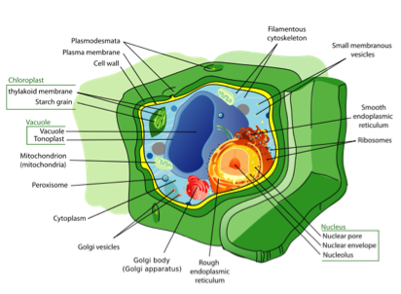
Reproduction may be vegetative by fragmentation or asexually by spores or sexually by gametes

Slide 7
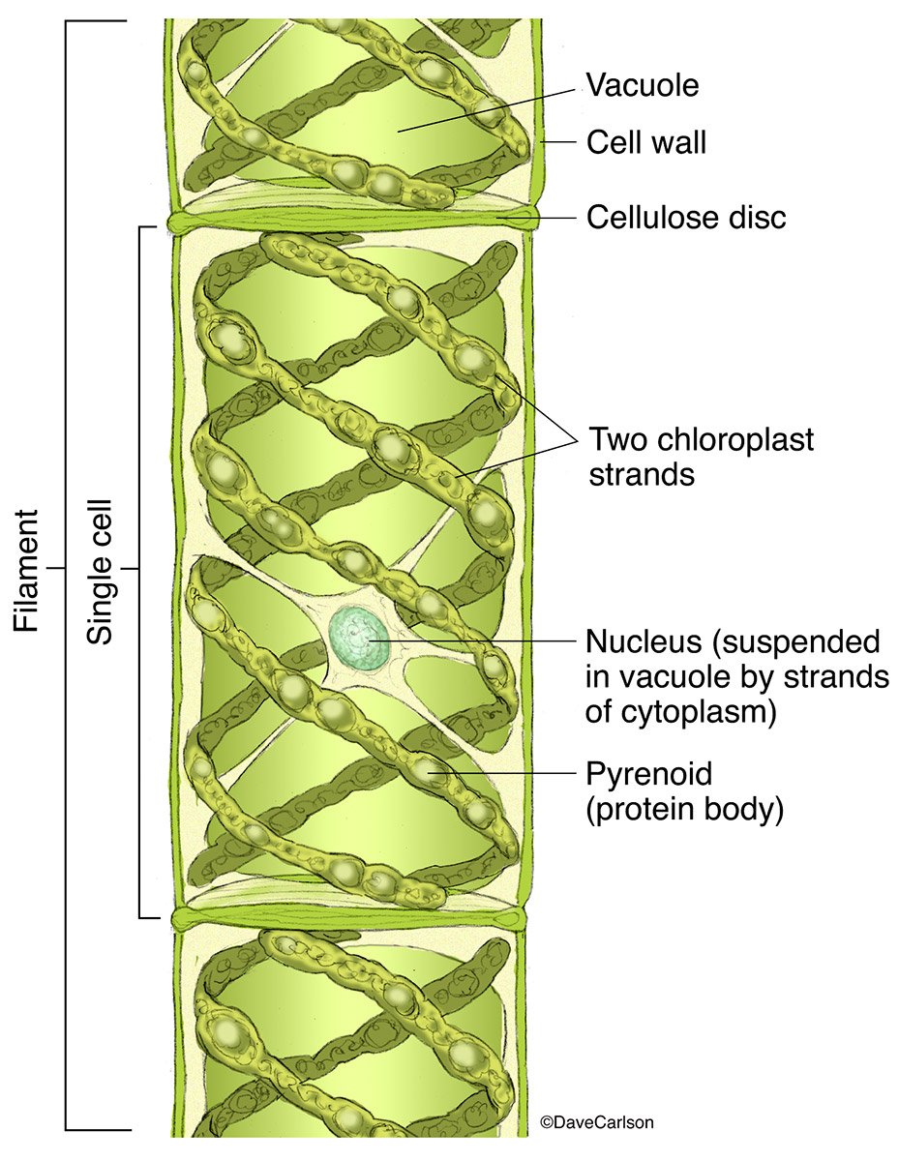

Slide 8
Division II. Eumycota – true fungi (Mycophyta)
sub division Mastigmycota Class -- Oomycetes
e.g Pythium Phytophthora
subdivision Zygomycotina Class Zygomyctes
e.g Mucor, Rhizopus
subdivision Ascomycotina Class Ascomycetes
e.g Saccharomyces, Aspergillus, Penicillium
subdivision Basidiomycotina Class—Basidiomycetes
e.g Mushroom
subdivision Deuteromycotina Class Deuteromycetes
e.g Cercospora

Slide 9
Five major phyla
Chytridiomycota – Chytrids
Zygomycota - conjugated fungi e.g Mucor, Rhizopus
Ascomycota – sac fungi e.g Aspergillus, Penicillium
Basidiomycota– club fungi e.g Mushroom
Deuteromycota – Imperfect fungi e.g Fusarium, Helminthosporium
Glomeromycota – arbuscular mycorrhizae

Slide 10
Fungi
Characteristics
Group of thallophytes lacking in chlorophyll with variety of shapes and sizes
Lead heterotrophic life either as parasites or saprophytes
Carbohydrate food is stored in form of glycogen
They could be unicellular e.g yeast or multicellular
Plant body in the multicellular form is made of interwoven mass of hyphae collectively called mycelium

Slide 11
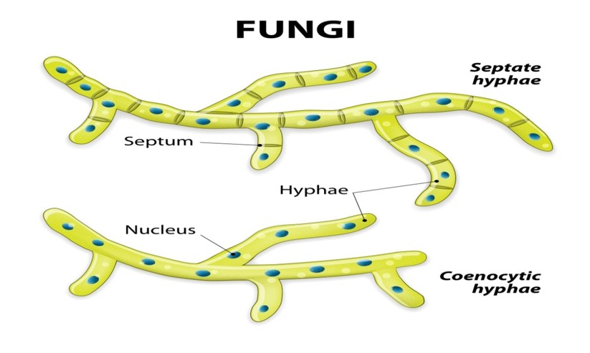

Slide 12
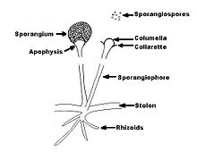

Slide 13
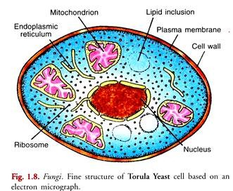

Slide 14
Wall of hyphae are made up of chitin or pure cellulose
Reproduction (Vegetative)
(i) Fragmentation of body into parts
(ii) Detachment of a part of the body
(iii) Sclerotium is a compact, head and rounded mass of hyphae
Asexual by many types of spores
(i) Zoospores
(ii) Ordinary spores i.e. gonidia borne in sporangia
(iii) Conidia which are formed singly or in chains by special hyphae or condiophores

Slide 15
(iv) Oidia short segments of vegetative hyphae
(vi) Ascospores form in sacs or Asci in numbers of 8 per sac
(v) Basidio spores borne in number of 4 in club like Basidium
Sexual reproduction takes place in these phases, which are:
Plasmogamy (fusion of protoplasm)
Karyogamy (fusion of nuclei)
With gametes and gametangia which may be isogamous, anisogamous or oogamous

Slide 16
Bryophytes (Byrophyta)
The Byrophytes comprise land inhabiting autotrophic plants which prefer moist and shady places
Vascular tissue is absent. True roots are absent. They have root-like structures called the rhizoids which help in anchorage and absorption of water and nutrients from the soil.
Bryophytes show an advance over most algae by the development of archegonia, multicellular antheridia and a distinct alternation of generation. The sporophyte is dependent on the gametophyte in the Bryophyte.
The gametophytic plant body is either thalloid (flattened) as in the mosses. The gametophyte predominates in the Bryophyta.

Slide 17
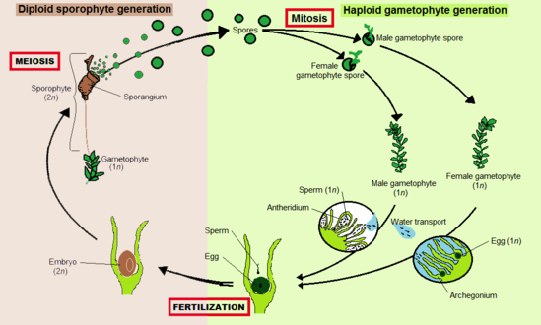
LIFE CYCLE OF BRYOPHYTE

Slide 18
PTERIDOPHYTES
The pteridophytes are seedless vascular plants. They differ from the bryophytes in three key respects.
The sporophytes does not remain attached to (a much reduced) gametophyte
It has true vascular tissues
It is larger, long lived phase of the life cycle
Most pteridophytes live in wet humid places, and their gametophyes lack vascular tissues.
Examples are the lycopodium, sellaginella, Fern (Dryopteris).

Slide 19
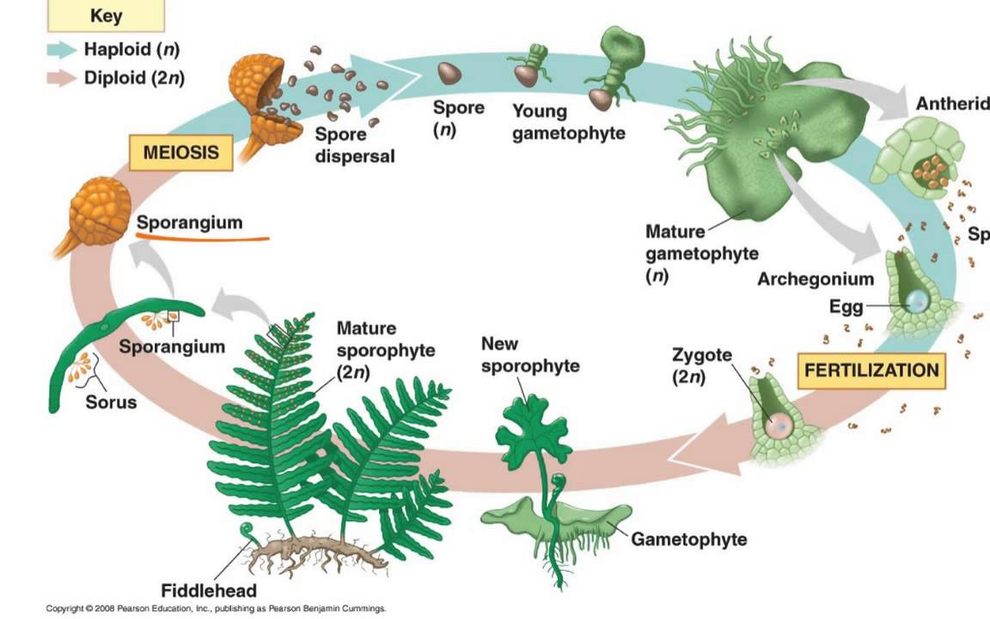
LIFE CYCLE OF PTERIDOPHYTE

Slide 20
ANGIOSPERM MORPHOLOGY
Angiosperms are flowering and seed-bearing plants.
They are higher plants with well developed root and vascular tissues.
Angiosperms are the most successful and most abundant group of plants.
They provide most of man’s food and raw materials. Over 250,00 species have been reported.
Factors responsible for the success of Angiosperms
Variability in structure
Genetic flexibility

Slide 21
Efficient pollination and fertilization mechanisms
Production of large number of seeds
Fast rate of growth
Short life cycle
Self fertility/bisexuality etc.
The angiosperms dominate the vegetation of West Africa and they are grouped into two classes namely
Monocotyledons
Dicotyledons

Slide 22
Monocotyledons and Dicotyledons
There is great variation among plants and they are grouped or classified based on the similarities and differences that exist among them.
This process of grouping plants is known as classification.
To classify plants, it is essential to have good knowledge of the variation in the features of the plants

Slide 23
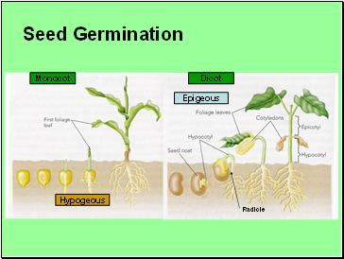

Slide 24
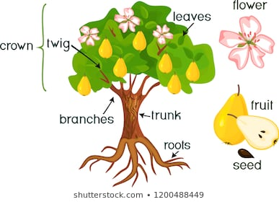

Slide 25
Morphology was derived from two Latin words Morphe = form and Logos = study.
Plant morphology deals with the study of forms and features of different plant organs such as roots, stems, leaves, flowers, fruits and seeds.
An angiospermic plant has
The root and shoot systems.
positioned below the ground level
its primary functions are fixation/anchorage of the plant to the soil and absorption of water and mineral salts from the soil into the plant.

Slide 26
The shoot system : plant part found above the ground level.
Comprises the stem, leaves, flowers, fruits and seeds.
Above plant organs are grouped into
Vegetative and reproductive parts.
Vegetative parts are the plant organs that are concerned with the nutrition and growth of the plant i.e. the root system and parts of the shoot system such as the stem and leaves.
The functions of stem and leaves
support, conduction and food manufacture.
Reproductive shoot comprises the flower for plant reproduction

Slide 27
NOMENCLATURE
The first of the two names is the generic name,
The second name is the specific name.
The first letter of the generic name is written in capital letter
The specific name is written in small letters all through.
The two names should be
underlined separately or
italicized when in prints.

Slide 28
Botanical name English Yoruba Hausa
Dioscorea alata White yam Isu ewura Doya
Garcinea cola Bitter kola Orogbo Mijigoro
Cola nitida Kola Obi gbanja Goro
Aspilia africana Marigold Yunyun Kausa
Zea mays Maize Agbado Masara

Slide 29
DESCRIPTION OF PLANTS
Plants can be described or classified based on
criteria such as -size -habit -habitat -life span -behavior etc.
Description based on size
Trees are plants with single hard or woody trunk that
carry branches well above the ground
e.g. Mangifera indica, Delonix regia
Shrubs are plants or small trees with two or more
woody trunks that developed from a single
rootstock e.g. Hibiscus sp, Ixora sp, Acalypha sp

Slide 30
Herbs are small plants with soft, fleshy stem e.g.
Talinum triangulae, Ageratum conyzoides,
Description based on duration of life
Annuals are plants that complete their
life cycle in one season i.e. one year e.g. Oryza sativa, Zea mays
Biennials are plants that complete their
life cycle in two seasons i.e. two years e.g. Allium cepa, Manihot esculenta
Perennials are plants that live for more than two years e.g. Milesia excelsa

Slide 31
Description based on habitats.
Plants are also described based on their habitats. Many plants have also developed features that adapt them to their specific habitats.
Mesophytes or land plants are plants growing in regions with average temperatures and moisture e.g. Tithonia diversifolia, Euphorbia heretophylla etc.
Xerophytes are plants growing in the desert or dry places e.g. Cactus sp., Euphorbia sp. Aloe sp., Agara sp.

Slide 32
Hygrophytes are plants growing in moist and shady places e.g. Ferns, some grasses.
Hydrophytes are plants growing in aquatic places e.g. water lettuce (Pistia), water hyacinth (Eichhornia sp.), water lily;
Halophytes are plants growing in saline soil or water e.g. Rhizophora sp., Kandelia sp., Mangrove plants etc.

Slide 33
Description based on nature of stem
Plants can be described as erect or scandent based on the nature of their stems.
Erect plants are those with strong stem that can stand on their own without any support.
Scandent plants are those having weak, long stem with diffuse which can not carry the plant upright. Scandent plants are called climbers if they attach themselves to other plants or objects by some means.

Slide 34
Examples are rootlet climbers e.g. Piper guinense, hook climber e.g. Bougainvillea, tendril climber e.g. Gloriosa superb, Passiflora edulis and stem climbers or twinners e.g. Dioscorea sp., Vigna p. Lianes or lianas are very thick and woody perennial climbers usually found in the forest. They climb round their supports e.g. Alafia barteri, Entad gigas.

Slide 35
Other scramblers and stranglers scandent plants are.
Scramblers do not attach to their support but simply lean against nearby plants and spread over them e.g. Combretum sp while
Stranglers start their life from seed which grow on the host or near the host. They produce shoot and roots systems which grow round the host and may later kill host by strangulation e.g. Ficus sp.

Slide 36
Under this, we have the following plant types:
Plant parasites: These are plants living on other living plants. They could be total parasite e.g. Cuscuta or partial parasites e.g. Mistletoe.
Epiphytes: These are plants that grow on other plants but they produce their food by themselves. They only attach themselves to the external part of the host e.g. Orchids.

Slide 37
Saprophytes: These are plants that grow on dead or decaying organic matter e.g. Monotropa.
Carnivorous plants: Capture insects and feed on them e.g. Bladderwort, Venus fly-trap, Butterwort, Pitcher plant etc.
Symbionts: Two organisms living together as if they are part of the same plant, and the two organisms benefit from the relationship.

Slide 38
The relationship is called symbiosis e.g. Lichen which is the association of fungi and blue-green algae which is seen as green patches on tree trunks and old walls.

